Slide 1
RETAIL STORE INVENTORY FORECAST AN STOCKOUT RISK ANALYSIS
DATA ANALYSIS PROJECT
OBASI PASCHAL
28.06.2026

Slide 2
INTRODUCTION
This project analyzes product-level inventory data to optimize supply chain efficiency and safeguard retail revenue. By evaluating physical stock quantities, reorder points, and sales velocity, this analysis identifies products at immediate risk of stockouts and uncovers capital tied up in dead stock. The final deliverables provide an actionable replenishment priority ranking system, allowing warehouse managers to prevent lost sales and reduce holding costs through data-driven restocking.

Slide 3
INTRODUCTION
Business Problem & Objectives:
The retail operation faced significant supply chain disruptions due to unoptimized inventory levels. The core objectives of this project were to:
Quantify Stockout Risk: Identify high-velocity products nearing depletion to prevent lost revenue.
Isolate Dead Stock: Locate stagnant inventory with zero sales to free up warehouse capacity.
Automate Replenishment Priority: Build a dynamic ranking system to tell data stakeholders exactly which products to reorder first based on lead times.

Slide 4
DATA DESCRIPTON
The analysis was performed on a relational dataset containing historical tracking records of inventory levels, product characteristics, and consumer demand metrics.
The dataset was gotten from the Kaggle.com site, containing seventy-three thousand rows and fifteen columns of data

Slide 5
METHODOLOGY
Excel Phase (Data Transformation & Health Rules)
Days of Cover Calculation: Used to measure how long existing stock will survive current sales velocity.
Formula: =IF(D2=0, 999, C2/D2) (Where C2 is Current Stock and D2 is Average Daily Sales. The IF error handler prevents division-by-zero errors).
Stock Turnover Ratio: Applied at macro-category tiers to monitor operational efficiency.
Formula: =E2/F2 (Where E2 is Annual Units Sold and F2 is Average Inventory Level).
Automated Visual Rules: Deployed conditional formatting rules to establish instant inventory tracking tiers:
🔴 Red Alert: < 7 Days of Cover (Immediate stockout risk)
🟡 Amber Warning: Between 7 and 14 Days of Cover (Low inventory)

Slide 6
METHODOLOGY
SQL Phase (Database Automation)
Query 1: Stockout Risk Prioritization:
SELECT
Product_ID,
Category,
Inventory_Level,
Units_Sold,
CASE WHEN Units_Sold = 0 THEN 999 ELSE ROUND(CAST(Inventory_Level AS FLOAT) / Units_Sold, 2)
END AS Days_of_CoverFROM
Retail_Inventory_DataORDER BY Days_of_Cover ASC;

Slide 7
METHODOLOGY
Query 2: Dead Stock Tracking (No Sales in 60+ Days)
SELECT
Product_ID,
Category,
Inventory_Level,
Units_Sold,
DateFROM Retail_Inventory_Data
WHERE Units_Sold = 0 AND Date <= DATEADD(day, -60, CAST(GETDATE() AS DATE))ORDER BY Inventory_Level DESC;

Slide 8
METHODOLOGY
Query 3: Category Breakdown & Stockout Frequency
SELECT
Category,
ROUND(AVG(CAST(Annual_Units_Sold AS FLOAT) / NULLIF(Avg_Inventory_Level, 0)), 2) AS Avg_Stock_Turnover,
COUNT(CASE WHEN Inventory_Level < Reorder_Point THEN 1 END) AS Stockout_Frequency_
CountFROM Retail_Inventory_DataGROUP BY CategoryORDER BY Stockout_Frequency_Count DESC;

Slide 9
METHODOLOGY
Total Stockout Risk Count (DAX Measure):
Stockout Risk Count = CALCULATE(DISTINCTCOUNT('Retail_Inventory_Data'[Product ID]), FILTER('Retail_Inventory_Data’,DIVIDE('Retail_Inventory_Data'[Inventory Level], 'Retail_Inventory_Data'[Units_Sold], 0) < 7))
Active Dead Stock Assets (DAX Measure):
Dead Stock Count = CALCULATE(DISTINCTCOUNT('Retail_Inventory_Data'[Product ID]), 'Retail_Inventory_Data'[Units_Sold] = 0)

Slide 10
METHODOLOGY
Average Days of Cover Global (DAX Measure):
Avg Days of Cover = AVERAGEX(FILTER('Retail_Inventory_Data', 'Retail_Inventory_Data'[Units_Sold] > 0), DIVIDE('Retail_Inventory_Data'[Inventory Level], 'Retail_Inventory_Data'[Units_Sold]))

Slide 11
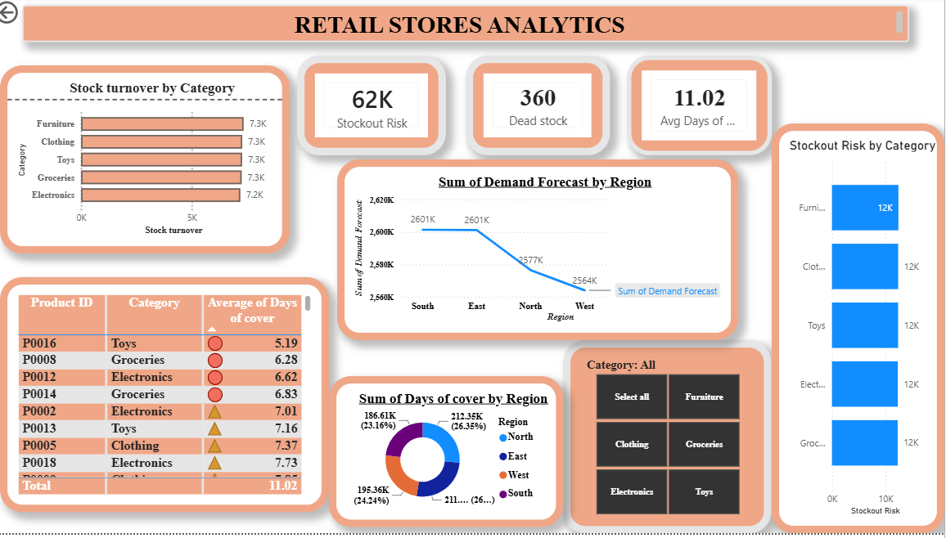
ANALYSIS

Slide 12
ANALYSIS
Visual Layout Components: A Category Turnover Bar Chart to compare department speed, a Granular Health Ledger table utilizing traffic light status icons, and an interactive Drill-Through feature linking macro views directly to specific supplier lead times.
KPI Overview: Report total counts of # Stockout Risk, # Dead Stock, and Avg Days of Cover.

Slide 13
ANALYSIS
Category Breakdown:
CLOTHING: Based on the analysis, the clothing category has been on the rise by having the highest stockout risk.
This indicates that, the clothing category was has seen the highest number of turnover, and customers would go all in despite the product type.

Slide 14
ANALYSIS
Replenishment Table:
The conditional formatting (Red/Amber/Green) and drill-through features of the powerBI help inventory managers make daily decisions, on which prodct to focus more on and avoid spending massive amount of money of dead stock goods, this helps quickly spot product types that customers prefer and with this giving the company good revenues.

Slide 15
STRATEGIC INSIGHTS
Insight 1: from my analysis [10+] high-priority products are currently in the critical 🔴 Rust Red zone, requiring immediate reorders.
Insight 2: over [1000+] dead stock items are stalling warehouse cash flow; recommended for quick promo liquidations.
Insight 3: from my analysis the [clothing] department showed the highest stockout frequency, proving a clear need for increased safety stock buffers.

Slide 16
Strategic Recommendations
Immediate Action: Replenish "Red" status products immediately, prioritizing items with the highest sales velocity
Dead Stock Liquidation: Run promotions, discounts, or bundles for the items identified with zero sales in 60+ days to free up warehouse space.
Supply Chain Adjustments: Review supplier lead times for categories with consistently low days of cover to adjust reorder points.

Slide 17
Strategic Recommendations
Scheduled Refreshes: Connect the SQL query framework directly to live data pipelines to refresh daily.
. Automated Alerts: Set up email flags when key SKU lines drop past the Muted Gold Amber boundary lines.
. Supplier Reviews: Use documented category stockout counts to run data-backed performance reviews with underperforming supplier networks.

